Slide 1
Web pages and Web Services
Shubheksha Adhikari

Slide 2
Internet
Vast interconnecting computers networks to communicate between computer networks and devices all over the world
Contain huge number of information resources and services and technologies developed by different individuals and organizations
Robert W. Taylor => development of ARPANET( prototype internet)
Vinton Cerf and Robert Kahn => developed TCP/IP technologies

Slide 3
Web pages
Collection of hyperlinks as a web document are web pages
Websites are collection of webpages that are linked together through common domain name
Collection of websites are World Wide Web(or simply Web)
Content of webpages are in HTML format, including CSS and JS which are accessible through internet
Each web page is identified by a distinct URL where user inputs the URL for a web page into their browser, then browser downloads an HTML file from a web server and transforms on user's device
On the basis of website deployment, there are two types:
a. static webpages
b. dynamic webpages

Slide 4
Static Webpages
Also known as flat pages or stationery pages
Difficult to manage because it should be edited in server if we have to change content in web page
Generally it is ready before accessed by user
Easier to code and assemble than dynamic
Common e.g.: resume websites, portfolio websites, brochure websites, one-off landing pages, and other informational or read-only sites

Slide 5
Dynamic Webpages
Displays different content each time its viewed
Easy to manage because web pages can be edited easily from dashboard without editing in server to change content of webpage
Generally rendered by database operations in server
Content of web page is generated by server each time it is accessed
Complex to code and assemble than static web pages
Commonly e.g.: E-commerce sites, Blogs, Calendars, or to-do sites, any site with information that must be updated regularly

Slide 6
Web Clients
Device that uses web browser and requests a web server for web resources
Application that uses HTTP to communicate with web server

Slide 7
Web Servers
It is computer software that listens and responds to a clients computer request made through a web browser
Machine that host web pages and other web development
Primary function of web server is to store, process and deliver web pages to web client
Accepts requests via HTTP or secure variant HTTPS
If user initiates communication by making a request for a web page or other resource using HTTP, and the server responds with the content of that resource or an error message
Also accept and store resources sent from the user agent if configured to do so
Other functions are virtual hosting, server side web scripting, bandwidth controlling to regulate network traffic

Slide 8
HTTP
Hyper Text Transfer Protocol
Defines how messages are formatted and transmitted and what actions web servers and browsers should take in response to various commands
Underlying protocol used by world wide web
Based on client-server model where client sends request and server sends a response

Slide 9
URL
Uniform Resource Locator
Address of given unique resource like HTML page, CSS document, an image etc. on web
Form of URI and standardized naming convention for addressing documents accessible over network

Slide 10
Client Side Scripting
Refers to writing class of computer programs(scripts) on web that are executed at client-side by user’s web browser
Scripts are embedded in HTML page itself(e.g.: JavaScript, JScript, VBScript)
Here source code is transferred from web server to users computer over internet and rundirectly in browser
Scripting language needs to be enabled on client computer

Slide 11
Server Side Scripting
Includes writing applications executed by server at run-time to process client input or generate document in response to client request
Consist directives embedded in web page for server to process before passing page to requestor
Used to provide interactive web sites that interface to databases or other data stores
Primary advantage to SSS is ability to highly customize response based on ability to highly customize response based on users requirement, access rights, or queries into data stores
Language used for SSS are PHP, ASP, Java, Python etc.

Slide 12
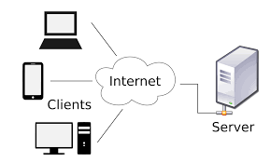
Client-Server Architecture
Computing model in which client requests server for resources
Server host, delivers and manages most of resources and services to be consumed by client
Has one or more clients connected to server over network for e.g. WWW

Slide 13
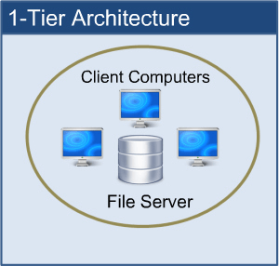
Types:
1. One-tier:
User interface, marketing logic, data logic are present in same system
data are stored in local system or a shared drive
Completely unscalable and only one user can access system at a given time via local client

Slide 14
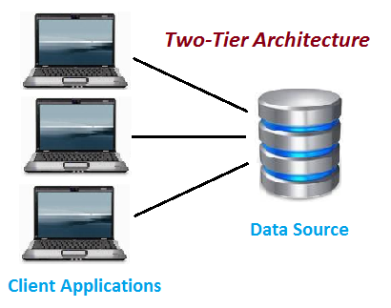
2. Two tier:
Client and server have to come in direct incorporation
Affordable architecture
If a client gives input to server, there is not any intermediate
Not suitable for security reasons

Slide 15
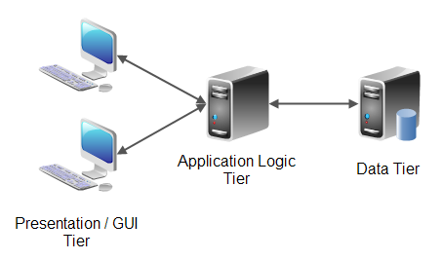
3. N tier :
Application tier is broken down into separate parts
Primary merit is they make load balancing possible
Easily scalable , servers experiencing high demand
Demerit is they are difficult to program and test due to its increased complexity

